Slide 1
New Deduplication Method for IVY
Enablement Innovation Services
September 22, 2018

Slide 2
Previous IVY Deduplication Method
Previously, for a specified target deduplication ratio, T, IVY would write data at a fixed copy number, C, that would be equal to T
Example: Given an array, A, and a desired deduplication ratio, T = 2, then A, when sequentially filled, would be A = [1, 1, 2, 2, 3, 3, …]
In the above example, the array A has the following properties: C = {2} at a probability distribution of N = {1}
When randomly writing data for a desired ratio, IVY would always write new data at a fixed copy number, C, that would be equal to T
However, it was found that the actual deduplication ratio would not be equal to the target ratio
By simulation, it was found that after many writes, desired deduplication target ratios of {2, 3, 4, 5, 10, 20} would actually be ~ {1.33, 1.64, 1.92, 2.19, 3.42, 5.56}

Slide 3
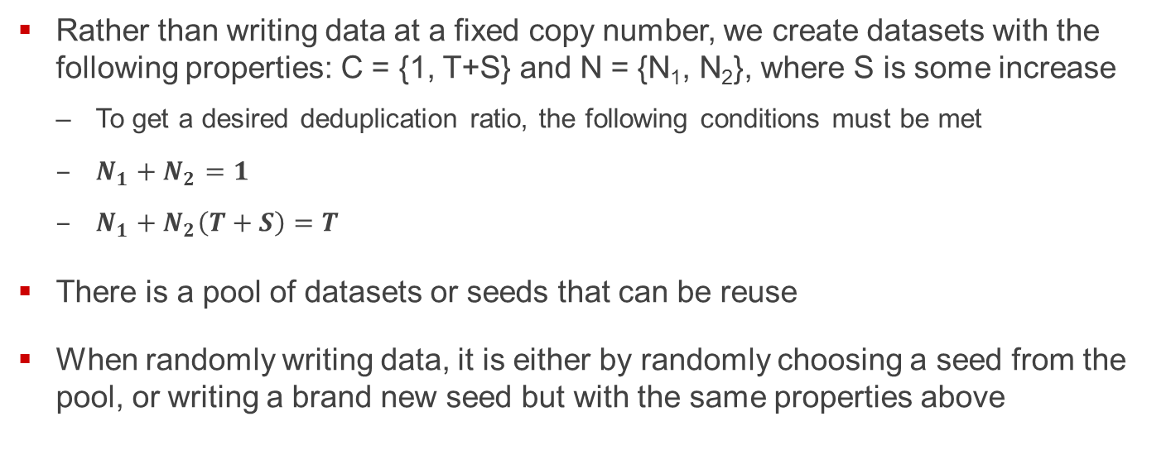
New IVY Deduplication Method
Rather than writing data at a fixed copy number, we create datasets with the following properties: C = {1, T+S} and N = {N₁, N₂}, where S is some increase
To get a desired deduplication ratio, the following conditions must be met
$N_{1}+N_{2}=1$
$N_{1}+N_{2}\left(T+S\right)=T$
There is a pool of datasets or seeds that can be reuse
When randomly writing data, it is either by randomly choosing a seed from the pool, or writing a brand new seed but with the same properties above

Slide 4
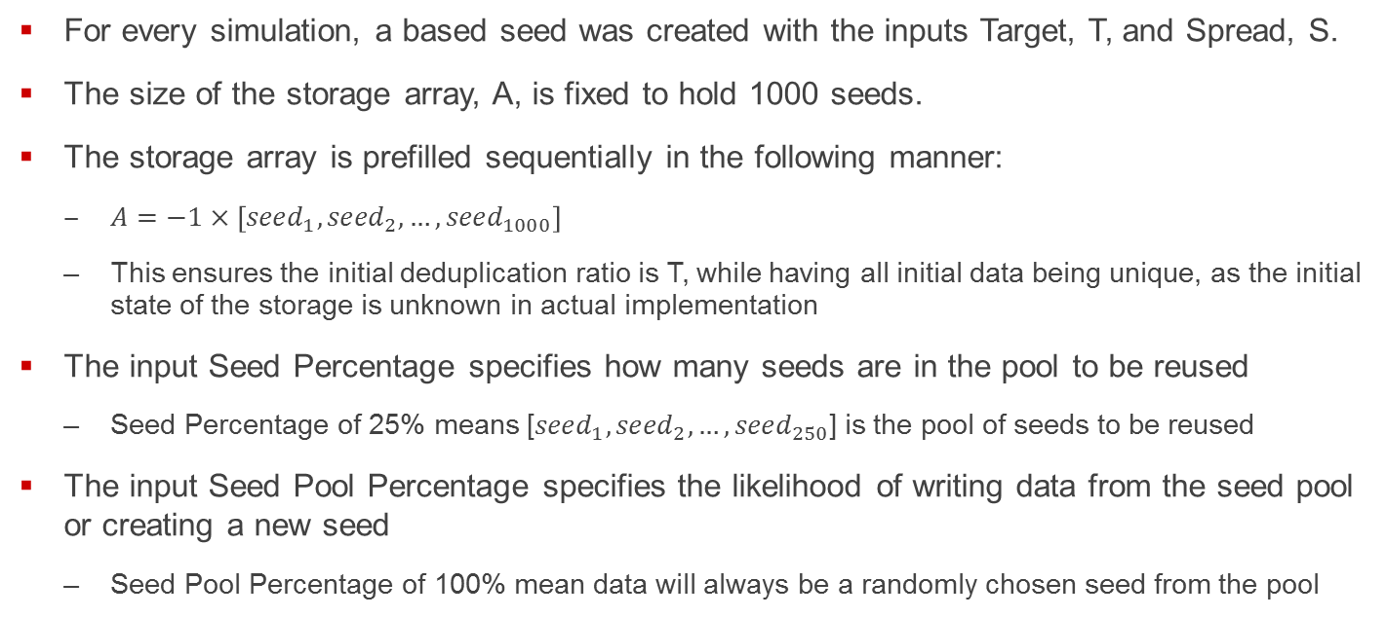
Matlab Simulation
For every simulation, a based seed was created with the inputs Target, T, and Spread, S.
The size of the storage array, A, is fixed to hold 1000 seeds.
The storage array is prefilled sequentially in the following manner:
$A=−1×\left[{seed}_{1},{seed}_{2},…,{seed}_{1000}\right]$
This ensures the initial deduplication ratio is T, while having all initial data being unique, as the initial state of the storage is unknown in actual implementation
The input Seed Percentage specifies how many seeds are in the pool to be reused
Seed Percentage of 25% means [${seed}_{1},{seed}_{2},…,{seed}_{250}$] is the pool of seeds to be reused
The input Seed Pool Percentage specifies the likelihood of writing data from the seed pool or creating a new seed
Seed Pool Percentage of 100% mean data will always be a randomly chosen seed from the pool

Slide 5
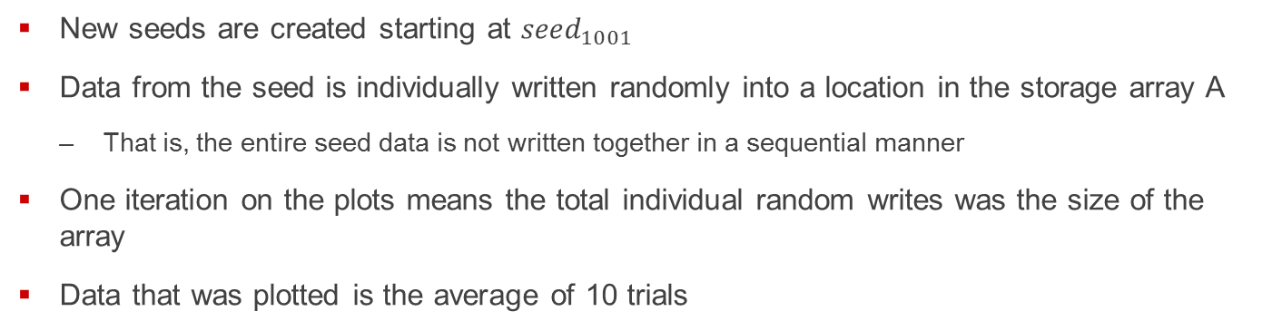
Matlab Simulation cont.
New seeds are created starting at ${seed}_{1001}$
Data from the seed is individually written randomly into a location in the storage array A
That is, the entire seed data is not written together in a sequential manner
One iteration on the plots means the total individual random writes was the size of the array
Data that was plotted is the average of 10 trials

Slide 6
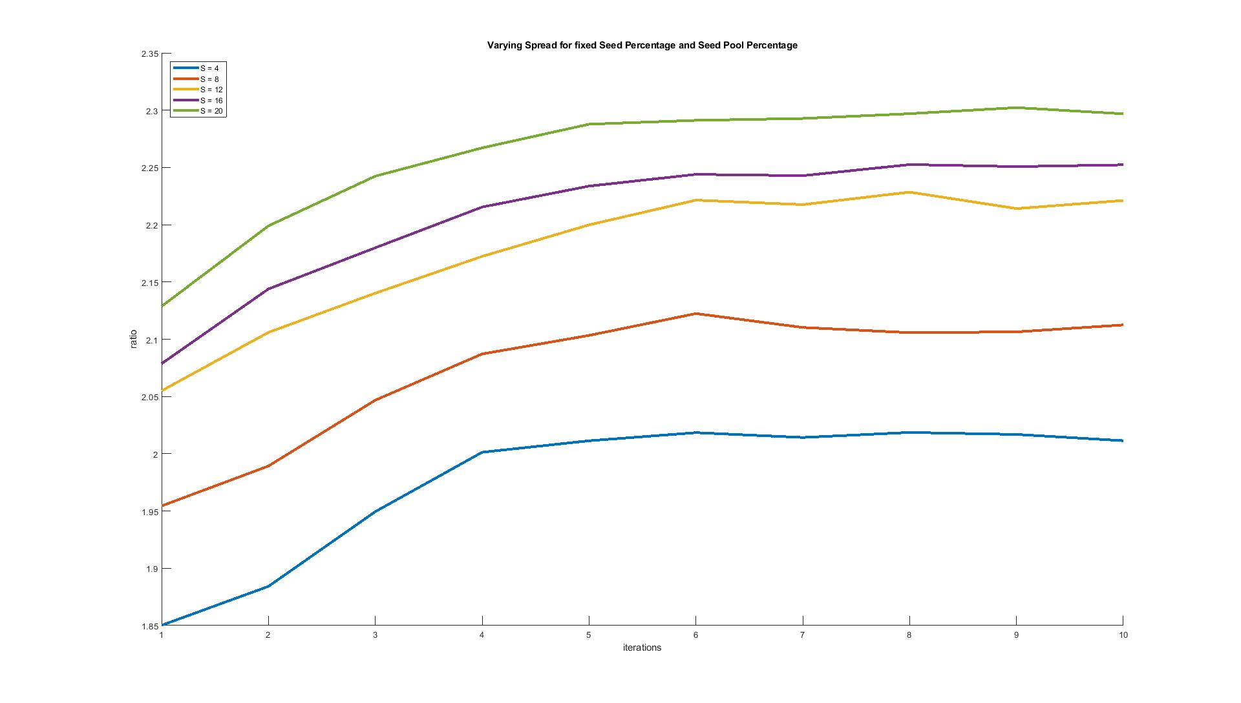
Results: Varying Spread, S, at Target 2:1, Seed Percentage of 50% and Seed Pool Percentage of 50%

Slide 7
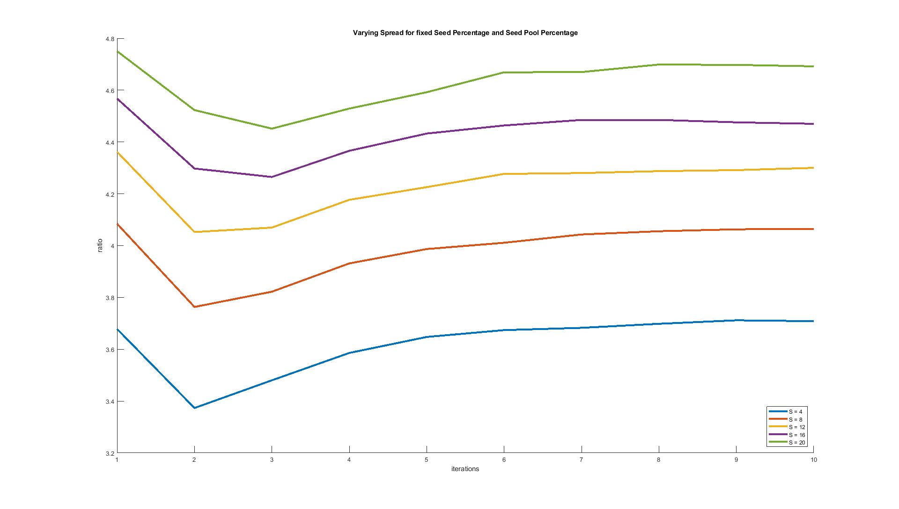
Results: Varying Spread, S, at Target 5:1, Seed Percentage of 50% and Seed Pool Percentage of 50%

Slide 8
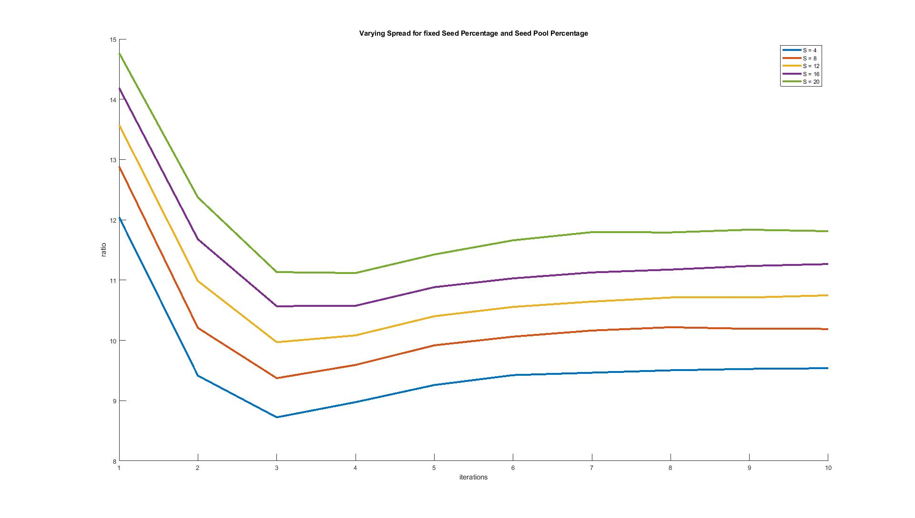
Results: Varying Spread, S, at Target 20:1, Seed Percentage of 50% and Seed Pool Percentage of 50%

Slide 9
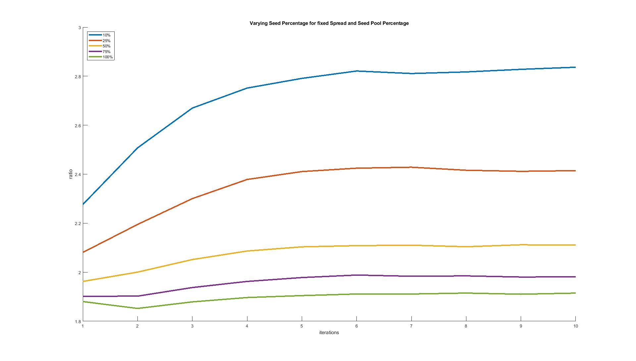
Results: Varying Seed Percentage, at Target 2:1, Spread of 8 and Seed Pool Percentage of 50%

Slide 10
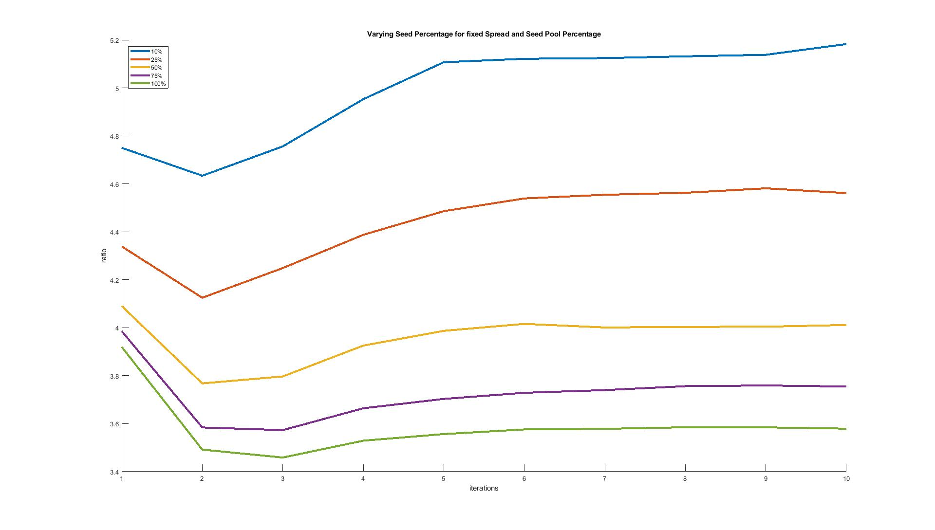
Results: Varying Seed Percentage, at Target 5:1, Spread of 8 and Seed Pool Percentage of 50%

Slide 11
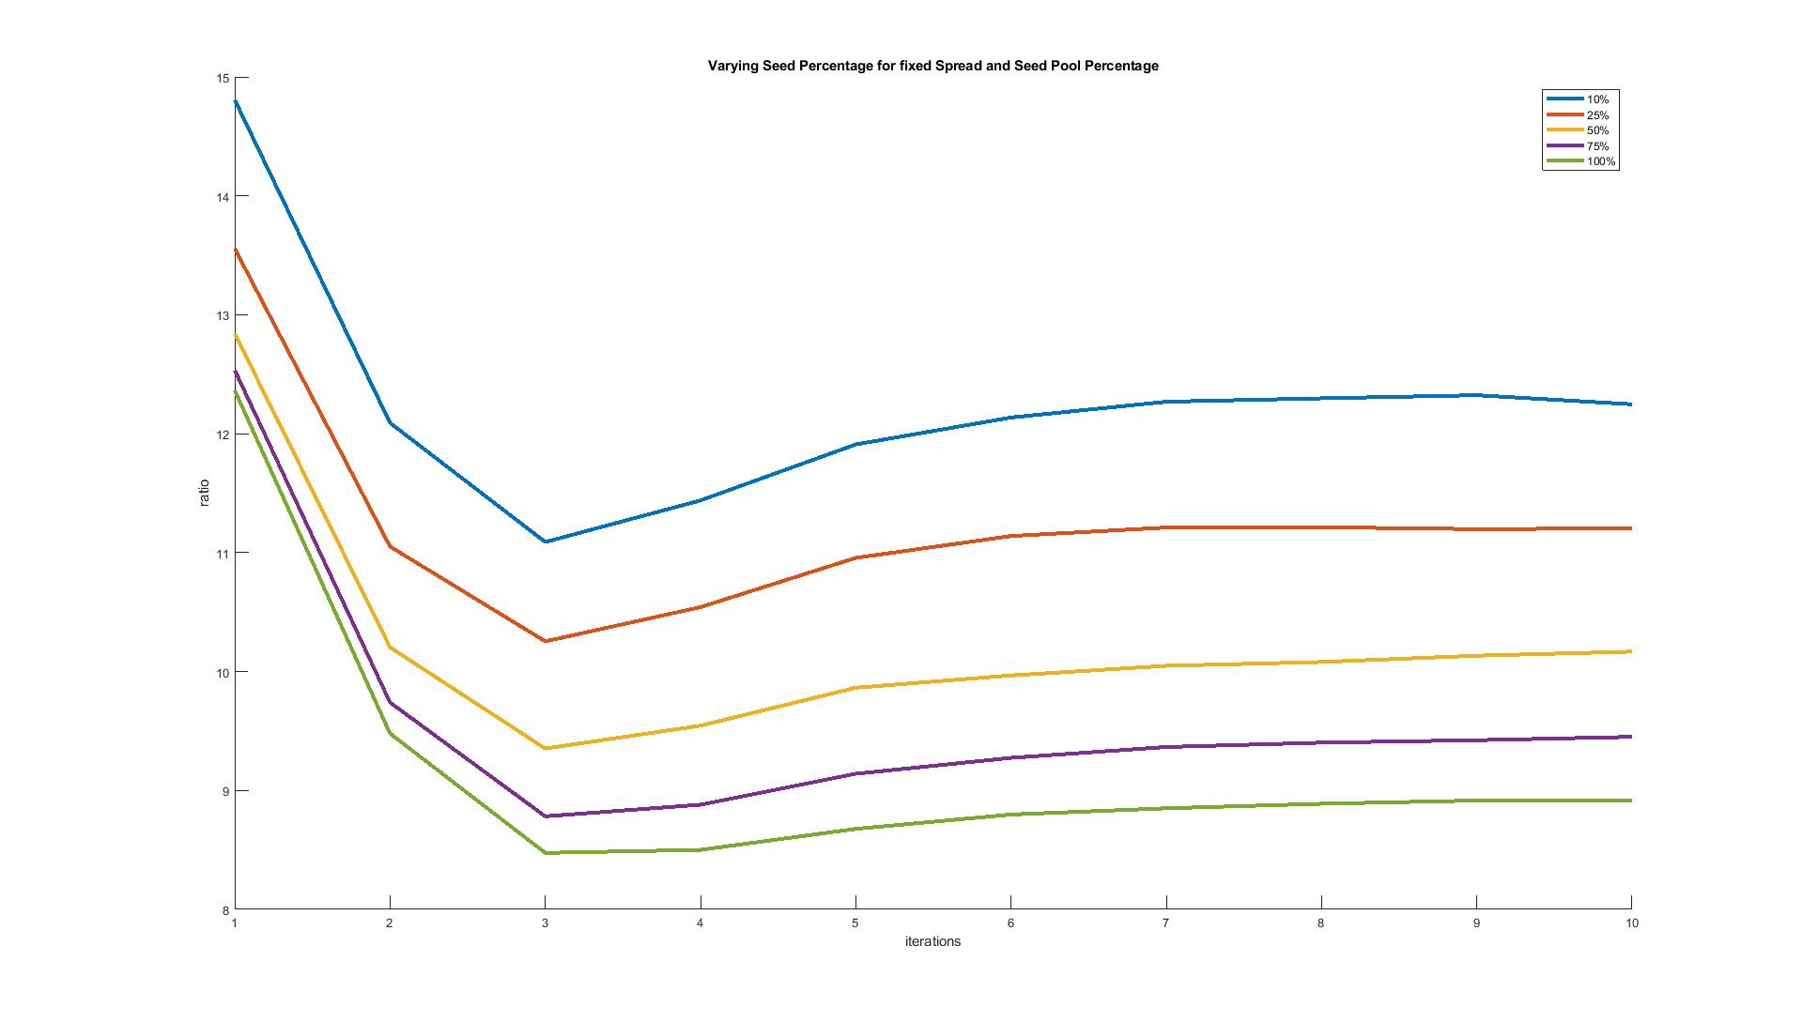
Results: Varying Seed Percentage, at Target 20:1, Spread of 8 and Seed Pool Percentage of 50%

Slide 12
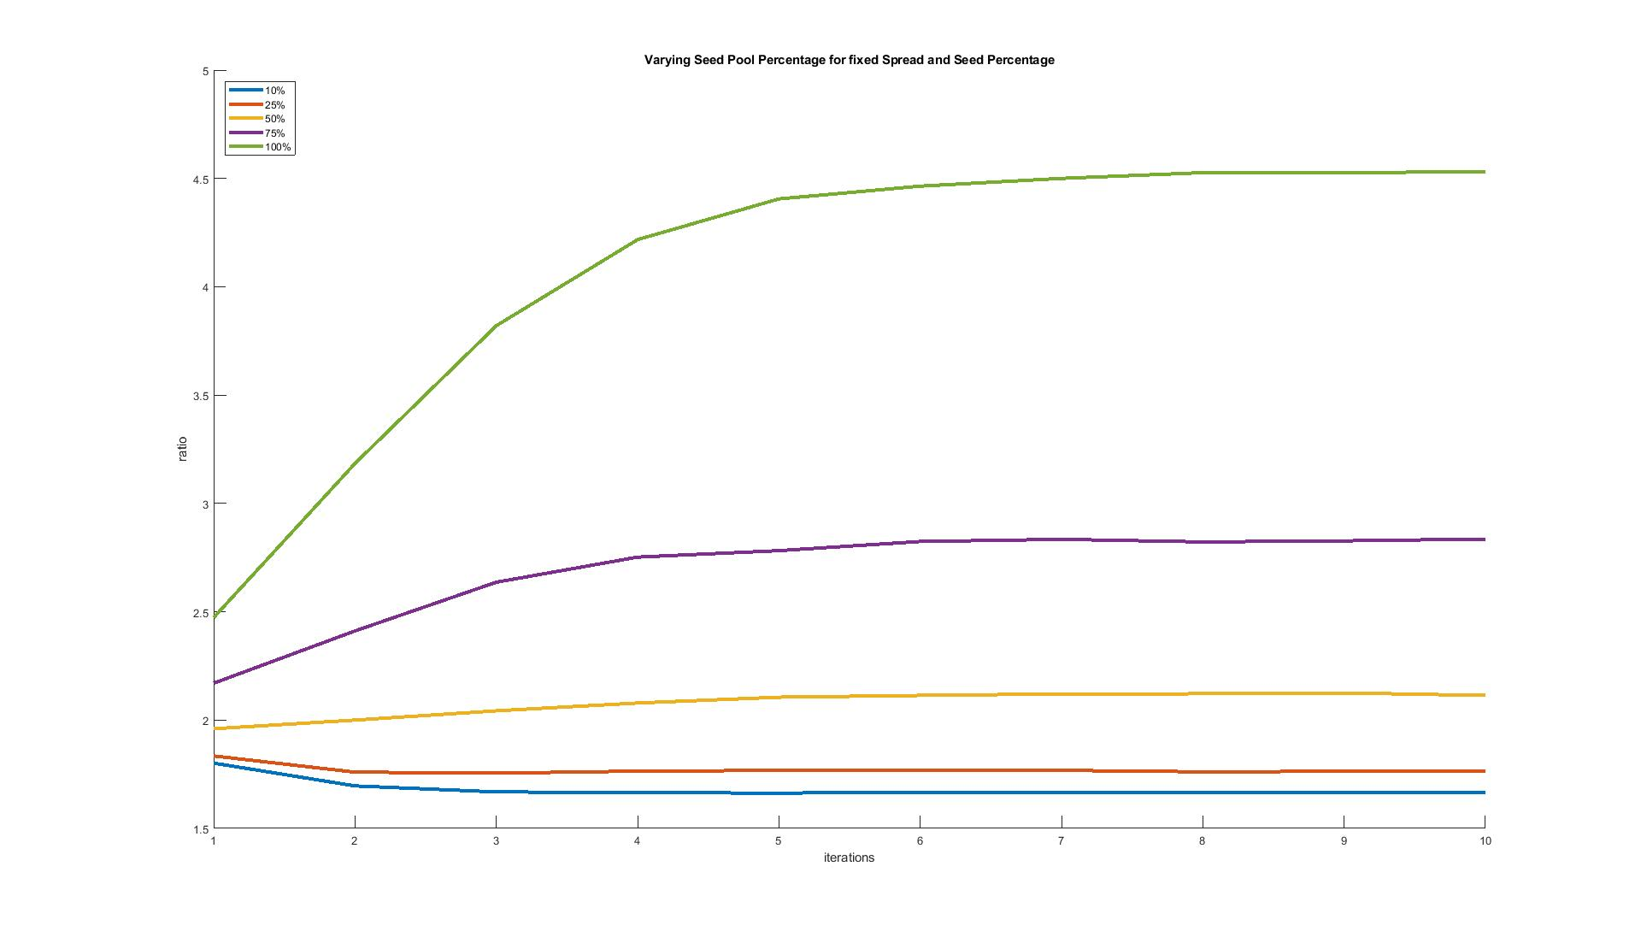
Results: Varying Seed Pool Percentage, at Target 2:1, Spread of 8 and Seed Percentage of 50%

Slide 13
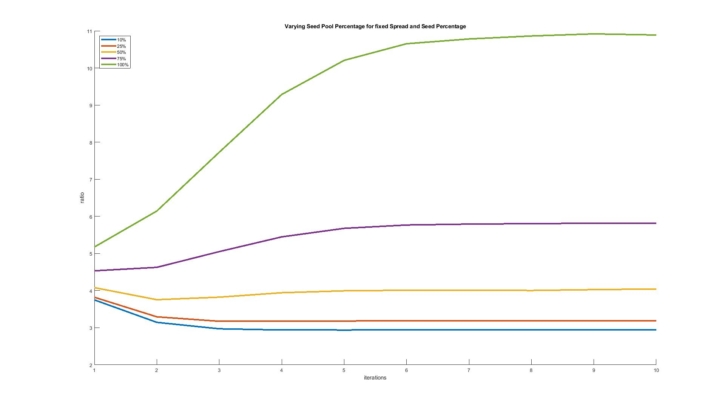
Results: Varying Seed Pool Percentage, at Target 5:1, Spread of 8 and Seed Percentage of 50%

Slide 14
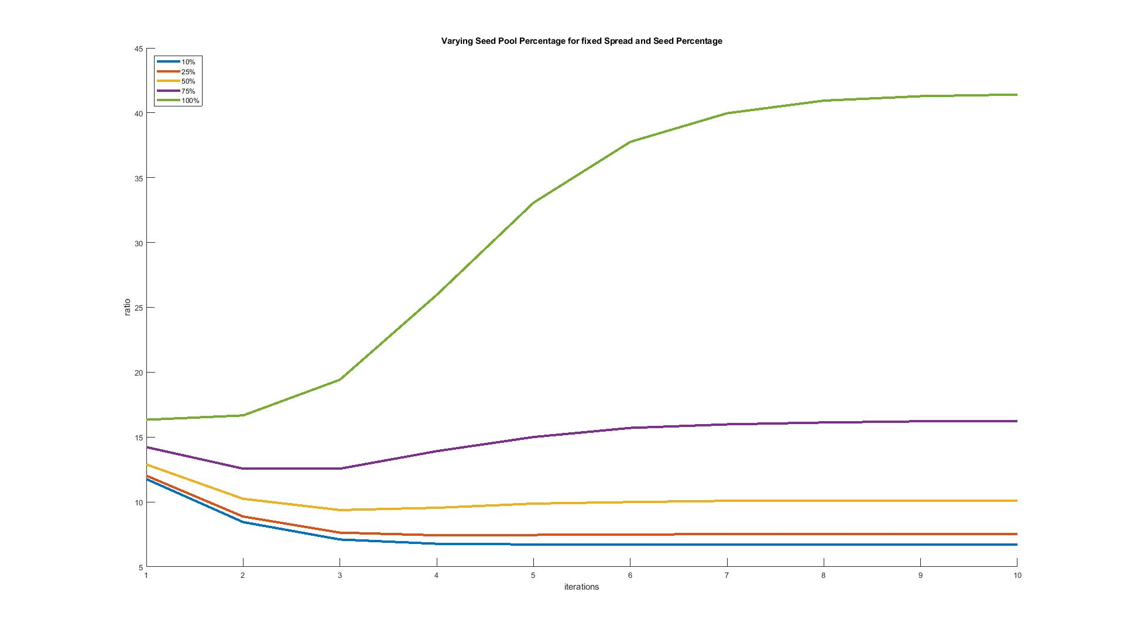
Results: Varying Seed Pool Percentage, at Target 20:1, Spread of 8 and Seed Percentage of 50%

Slide 15
Observations
As previously shown, increasing the spread increases the ratio
However, it is not as drastic as the other inputs, and can probably stay fix
Increasing the number of seeds in the pool to reuse decreases the ratio
Expected, as there is more data that can be randomly written in the storage array
Increasing the likelihood that the seed to be randomly written is from the reused seed pool increases the ratio, and has the largest effect on the ratio
Possible solution: Keep the spread fixed, keep the number of seeds fixed to a number or fixed to a percentage of the storage array, and vary the seed pool percentage to be proportional to the savings rate.
For example, let the spread be 8, the seed percentage to be 100% (the number of seeds in the pool equals the amount of seeds to fill the array) and the seed pool percentage be 1-1/T

Slide 16
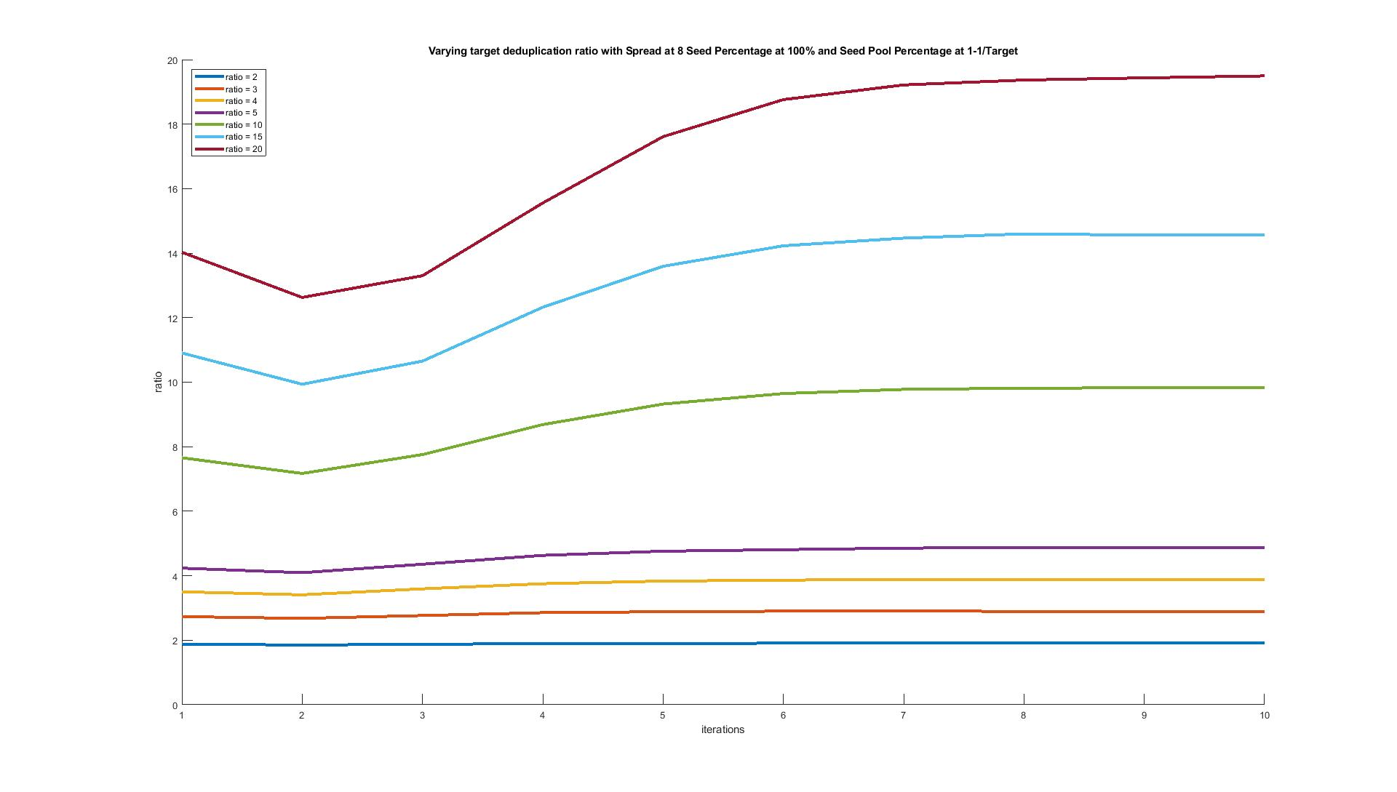
Results: Varying Target Ratio, Seed Pool Percentage at 1-1/T, Spread of 8 and Seed Percentage of 100%
Target 20, Got 19.5
Target 15, Got 14.58
Target 10, Got 9.84
Target 5, Got 4.87
Target 4, Got 3.87
Target 3, Got 2.89
Target 2, Got 1.92

Slide 17
Comparing Post Processing Time
Assumption: Post processing time is proportional to the number of unique data found in the storage array
That is, data that doesn’t have any other copies takes up the majority of the post processing time,
Note: Storage array size is the same when comparing between old and new method, not between ratios
New method has a larger spread of number of copies due to repeating data from the reused seeds

